Slide 1


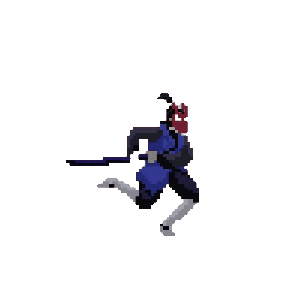

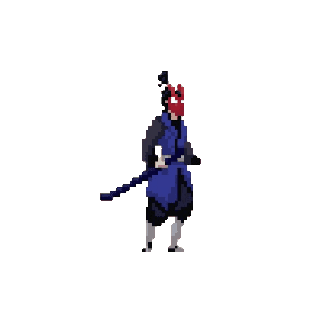

warrior’s
Wrath
START
Game presentation

Slide 2
warrior’s
Wrath
Game presentation
START

Slide 3





Table Of Contents
1
2
3
About the developers
Introduction to our game
Tools used to make the game

Slide 4
Table Of Contents
4
5
6
Features added to the game
problems we faced
conclusion

Slide 5
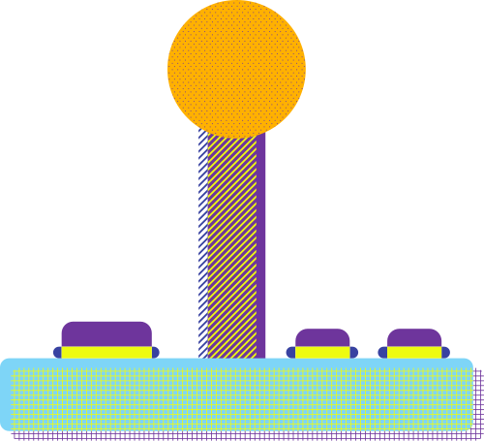


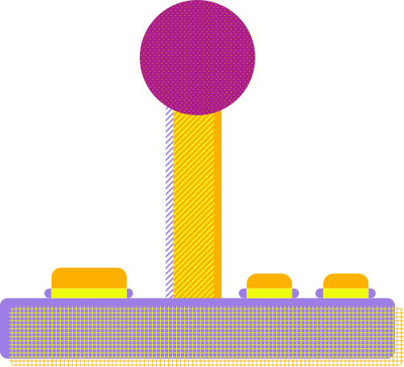
About the developers
1

Slide 6


Our Team
Who we are?
Briefly elaborate on what you want to discuss.
What we do?
Briefly elaborate on what you want to discuss.

Slide 7

Introduction to our game
2

Slide 8



Warrior's Wrath
2D
2P game
Developed in PC
2 dimension game
Developed using python
Play with your friends
an exhilarating 2D fighting game
Developed using the powerful Pygame library

Slide 9

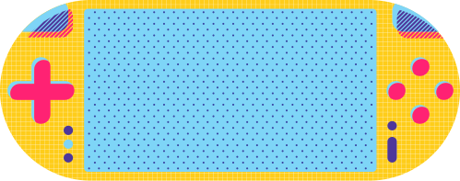

Tools used to make the game
3

Slide 10



For game developing
The cornerstone of "Warrior's Wrath" is the Pygame library, a robust set of Python modules specifically designed for game development. Pygame provides a versatile platform for creating 2D games, offering functionalities for handling graphics, input, and audio. With its simplicity and flexibility, Pygame empowers developers to bring their game ideas to life, making it an ideal choice for projects like "Warrior's Wrath."

Slide 11



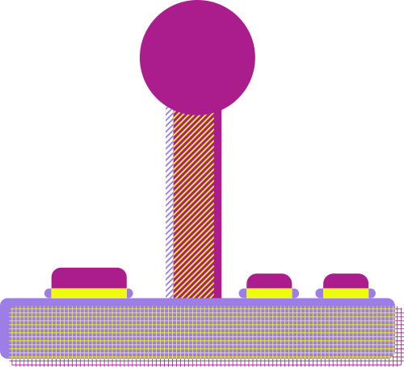
For the game intro
To kick off the gaming experience with a captivating introduction, MoviePy was employed. MoviePy is a Python library for video editing that seamlessly integrates with Pygame. This tool allowed the incorporation of an engaging intro video, setting the tone for the players and immersing them in the narrative of "Warrior's Wrath."
Studio
Entertainment
PRESENTS

Slide 12



Programs used
Adobe photoshop
Filmora 13

Slide 13


Adobe photoshop
Programs used
Filmora 13
In the dynamic world of game development, creating a visually stunning and engaging introduction is a crucial element in capturing the player's attention. For "Warrior's Wrath," the intro video serves as a gateway to the game's immersive world, setting the stage for the epic battles that await. The tool of choice for this cinematic endeavor was Filmora 13, a versatile and user-friendly video editing software.

Slide 14
Programs used
Adobe photoshop
Filmora 13
In the realm of game development, visual elements play a critical role in conveying the essence and excitement of the gaming experience. For "Warrior's Wrath," the creation of dynamic and visually striking character animations was achieved through the powerful capabilities of Adobe Photoshop. This indispensable tool was employed to craft sprite sheets and meticulously adjust animation sizes, ensuring that each character in the game possesses a distinct and captivating presence.

Slide 15
Features added to the game
4

Slide 16
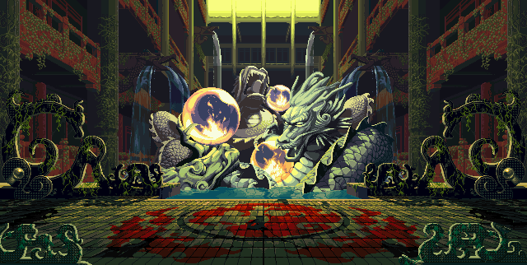



1- game menu
What can you say about your projects? Share it here!
start

Slide 17
Subscription Plan
20$
30$
300$
MONTHLY
MONTHLY
YEARLY
Add a feature
Add a feature
Add a feature
Add a feature
Add a feature
Add a feature

Slide 18


About Me
Elaborate on what you want to discuss.

Slide 19
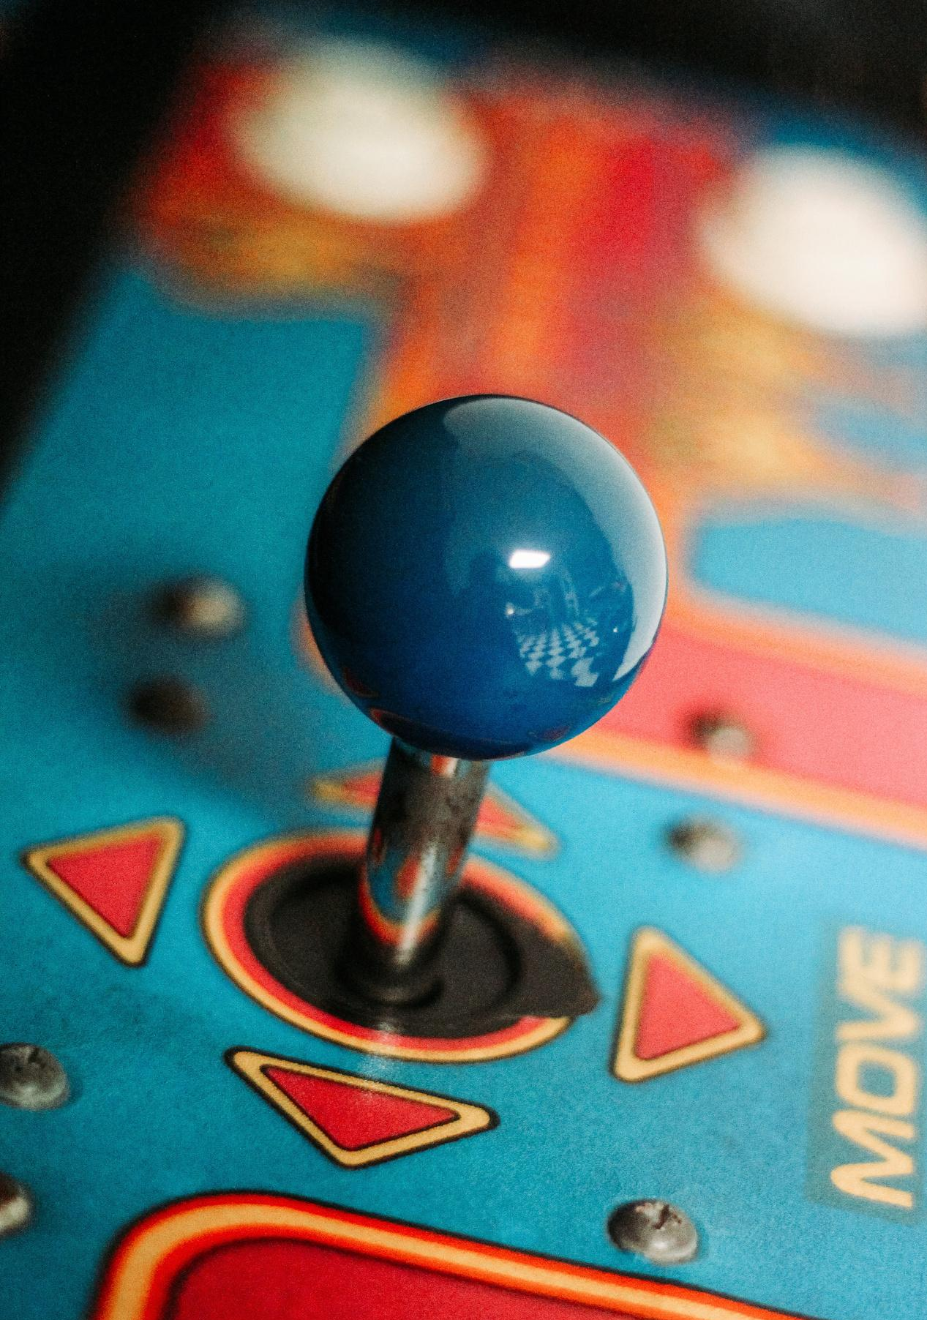

Our History
Presentations are communication tools that can be used as demonstrations, lectures, speeches, reports, and more. It is mostly presented before an audience.

Slide 20
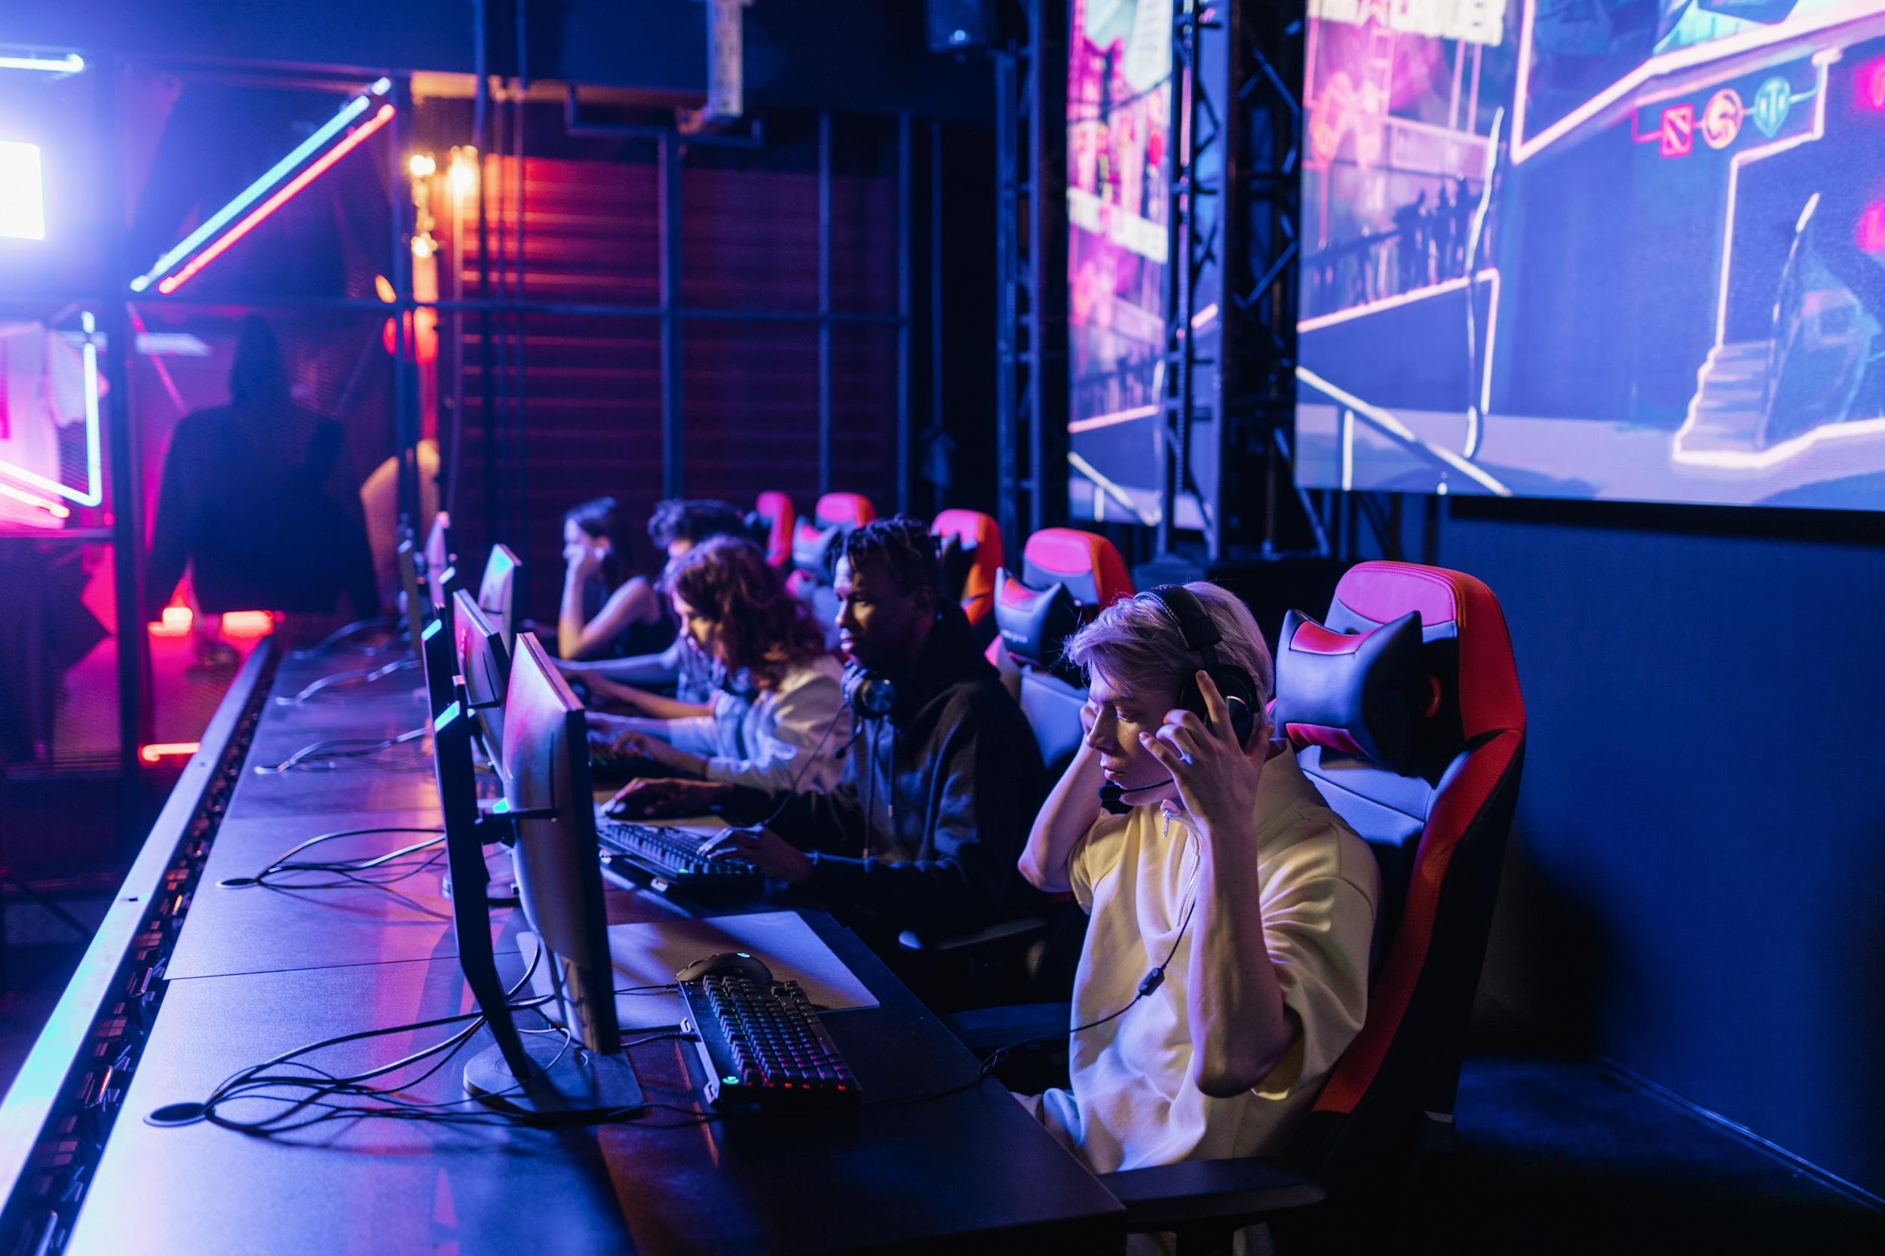

Write an original statement or inspiring quote
— Include a credit, citation, or supporting message

Slide 21


Our Founder
Name Surname
Presentations are communication tools that can be used as demonstrations, lectures, speeches, reports, and more. It is mostly presented before an audience.

Slide 22




Testimonials
Client name
Client name
Client name
Elaborate on what you want to discuss.
Elaborate on what you want to discuss.
Elaborate on what you want to discuss.

Slide 23

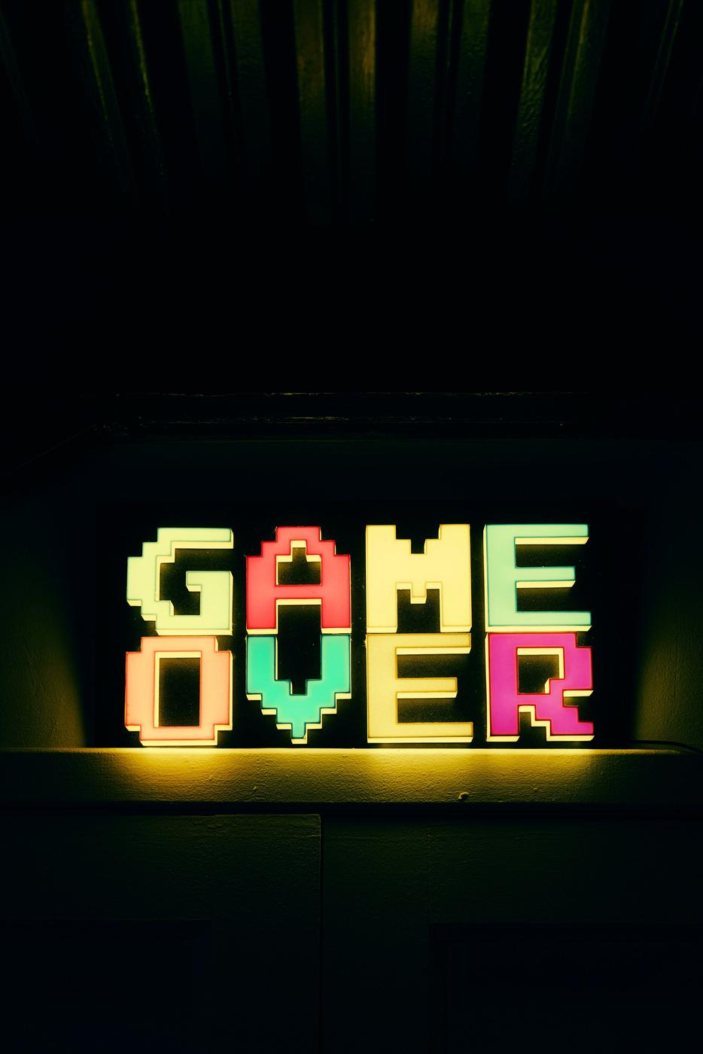
Thank you!
Write a closing statement or call-to-action here.

Slide 24
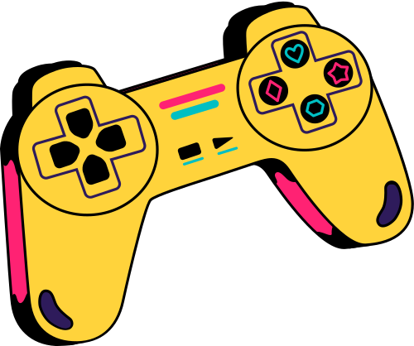


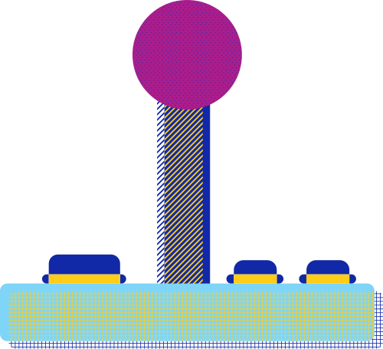










Resource
Page
Use these design resources in your Canva Presentation.
You can find these fonts online too. Happy designing!
Don't forget to delete this page
before presenting.
This presentation template uses the following free fonts:
Titles: Black Ops One, Disket Mono, Yeseva One
Headers: Black Ops One, Disket Mono
Body Copy: Stadio Now Monolinea
START

Slide 25


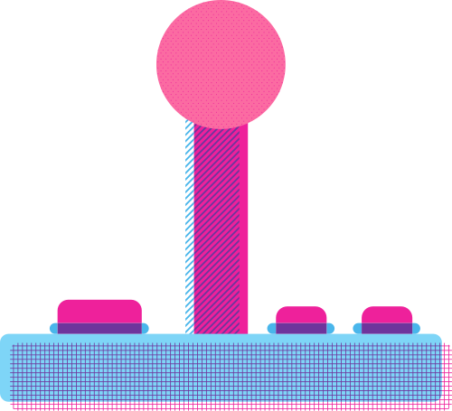
Credits
This presentation template is free for everyone to use thanks to the following:
SlidesCarnival for the presentation template
Pexels for the photos
Happy designing!

